Slide 1
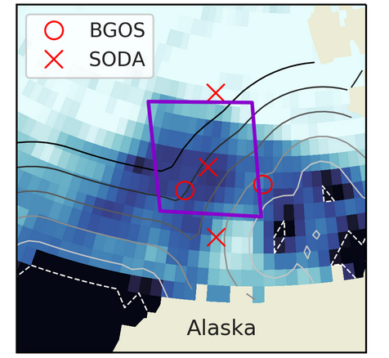
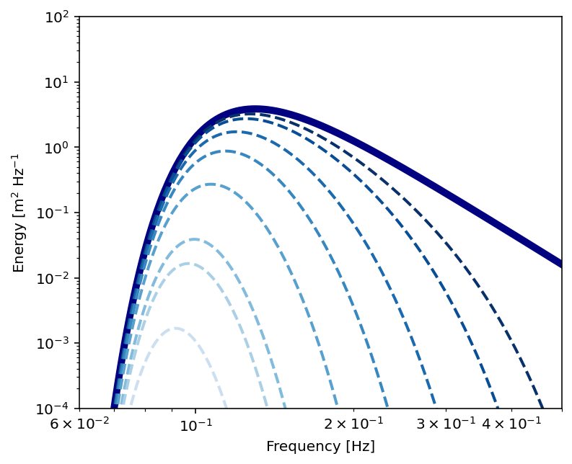
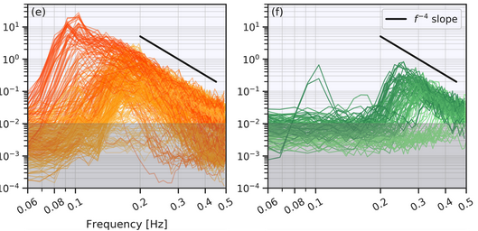
Expectation
Observations say that there are wind waves in sea ice even at 100 km into the ice. They can’t be propagating in from outside the ice since they’d be attenuated after a few tens of km. They must be locally generated. That means we should have wind wave input and sea ice attenuation simultaneously, in the same grid cell. This happens in WW3 but the numerical solution was over damping. The model matched the expectation below, and disagreed with the observations
Observations
0-100 km
100+ km
Initial incident spectrum
Wave Energy (m² Hz⁻¹)
Increasing distance in ice
High frequencies (tied to local winds) attenuated most rapidly in ice
Low frequencies (swells) survive deeper into the ice
Follows power law for fetch-limited local wind waves
Mixture of swell + local wind waves
Cooper, Roach, Thomson, Brenner, Smith & Bitz (2022)

Slide 2
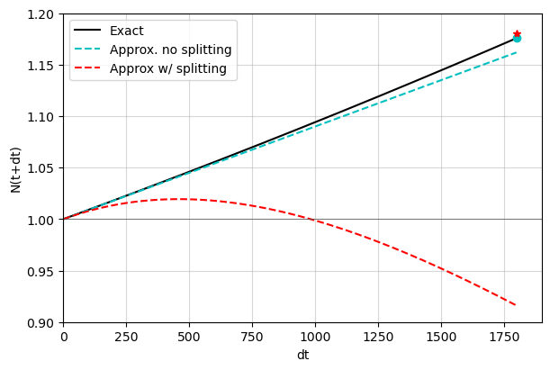
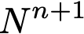
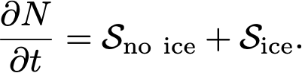
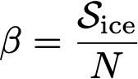
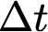
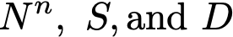
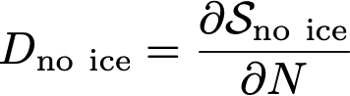
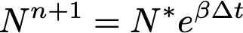
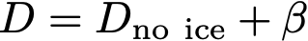
Wavewatch III needed improved numerics
For documentation and a Python notebook demonstrating the problem see
Exact
https://github.com/cmbitz/WW3Numerics
Improved Merged Numerics
The wave action energy spectrum N depends on net sources S:
Original Split WWIII Numerics
is linear in N, so WWIII solved it with time splitting:
Original WWIII Numerics
A solution given particular
as a function of . Exact and Improved wave energy are growing, while original WWIII has less growth and even damps at longer (typical) .
where
Inaccurate when D_{no ice}>0
where
Fix is simple: Do not time split! Keep semi-implicit solution
where
Improved because D<D_{no ice}
Notes:
\frac{\partial N}{\partial t} =
{\cal S}_{\rm no\ ice} + {\cal S}_{\rm ice}.
\frac{N^* - N^n}{\Delta t} = {\cal S}_{\rm no\ ice}(N^n) +
\epsilon ( N^* D(N^n) - N^n D(N^n) )
\frac{N^{n+1} - N^n}{\Delta t} = {\cal S}_{\rm no\ ice}(N^n) + {\cal S}_{\rm ice}(N^n)
\epsilon ( N^{n+1} D(N^n) - N^n D(N^n) )
D_{\rm no \ ice} = \frac{\partial {\cal S}_{\rm no \ ice}}{ \partial N}
\frac{N^* - N^n}{\Delta t} = {\cal S}_{\rm no\ ice}(N^n) +
\epsilon \left( N^* D_{\rm no\ ice}(N^n) - N^n D_{\rm no\ ice}(N^n) \right)
The semi-implicit solution on the first equation helped with stability but accuracy is controlled by delta t
WW3 had subcycling on the first equation to improve accuracy but it was turned off so the curves in the fig do not have subcycling
The dot and star in the fig are the solutions with subcycling 90 times to prove both solutions can be excellent even if unaffordable
Isn’t latex great
{dN \over dt} = S_{\rm non\ linear} + ND_{\rm non\ sea\ ice}(N) + ND_{\rm sea\ ice}
N^* - N^n = \left( S_{\rm non\ linear} + ND_{\rm non\ sea\ ice}(N) \right) \Delta t
N^{N+1} = N^* e ^{D_{\rm sea\ ice} \Delta t}
N^* - N^n = \left( S_{\rm non\ linear} + N^* D_{\rm non\ sea\ ice}(N) \right) \Delta t
N^n, \ S, {\rm and }\ D
N^{n+1} - N^n = \left( S_{\rm non\ linear} + N^{n+1}\left(D_{\rm non\ sea\ ice}(N^n) + D_{\rm sea \ ice} \right) \right) \Delta t

Slide 3
Next we’ll demonstrate the impact of the numerics in CESM simulations and in some very idealized applications from the Python notebook.
CESM3 Developmental Model
Using CMEPS and NUOPC in cesm2.3beta17
Atmosphere
(forced by JRA55 Reanalysis)
Joint floe-size thickness distribution (FSTD) in CICE6 (not default setup but available in CICE6 code base)
Wave attenuation in ice after Meylan et al. (2021). This is option IC4M8 (or maybe IC4M12 depending on which version of WW3)
Improved WWIII model numerics mandatory! This is described in the notes pdf in detail, called “merged” numerics
Sea Ice
(CICEv6 +
floe size model)
Ocean Waves
(WavewatchIII)
Ocean
Ocean
General Circulation Model (MOM6)
2/3º Tri pole global grid
All tests shown here are with IC4M12. But the improved merged numerics should work with any IC and IS option, though it leaves IS2 solved with splitting

Slide 4
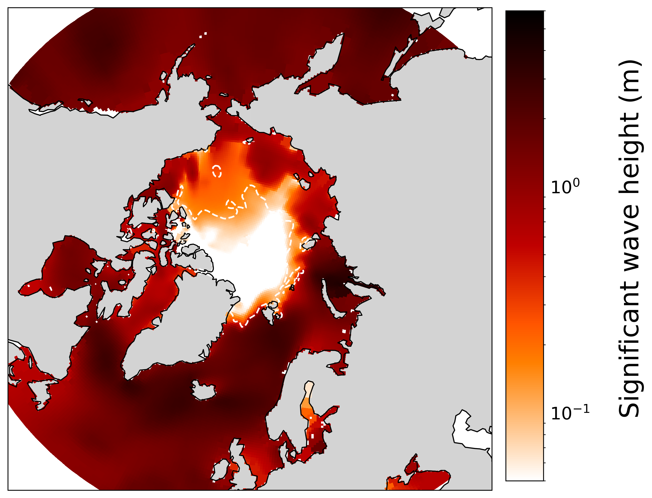
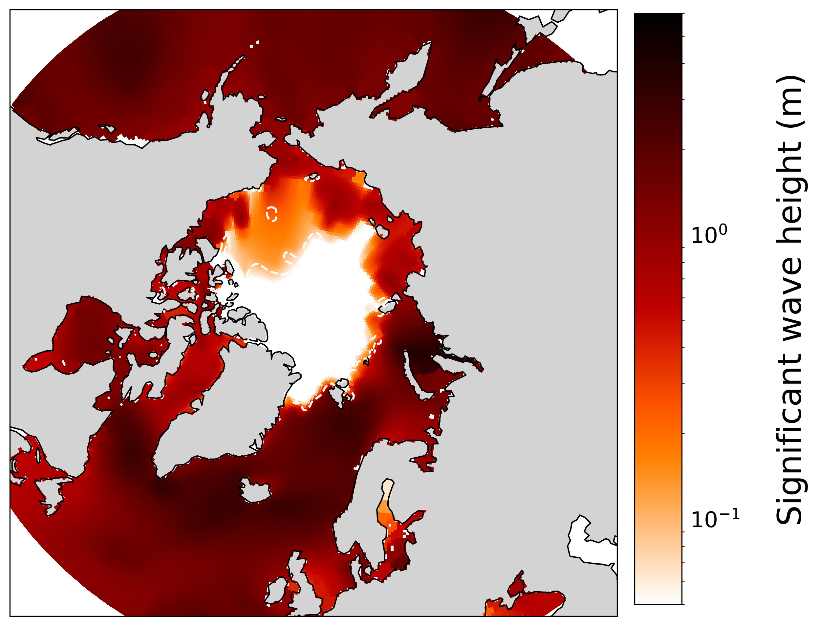
Waves are Attenuated Strongly in Sea Ice, Heights are Larger in Ice with Improved Numerics Look near the dashed line!
Improved Merged Numerics
Original Split WW3 Numerics
On Aug 10, 2012, during Great Arctic Cyclone
Concentration 15%

Slide 5
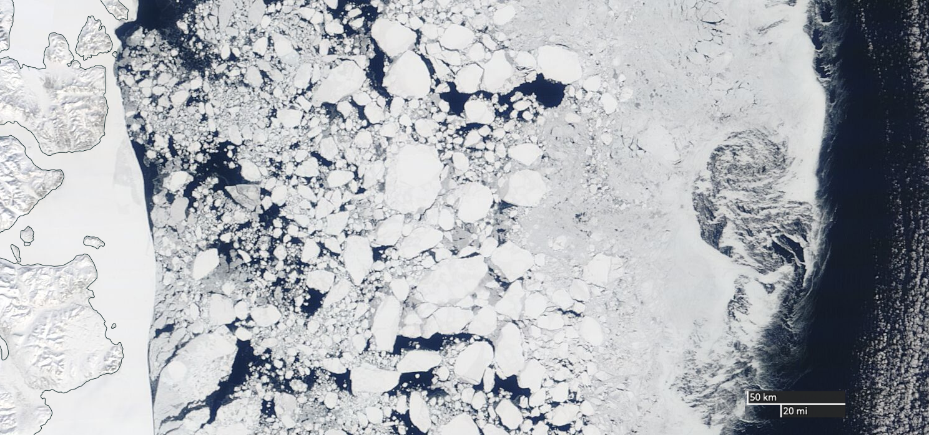
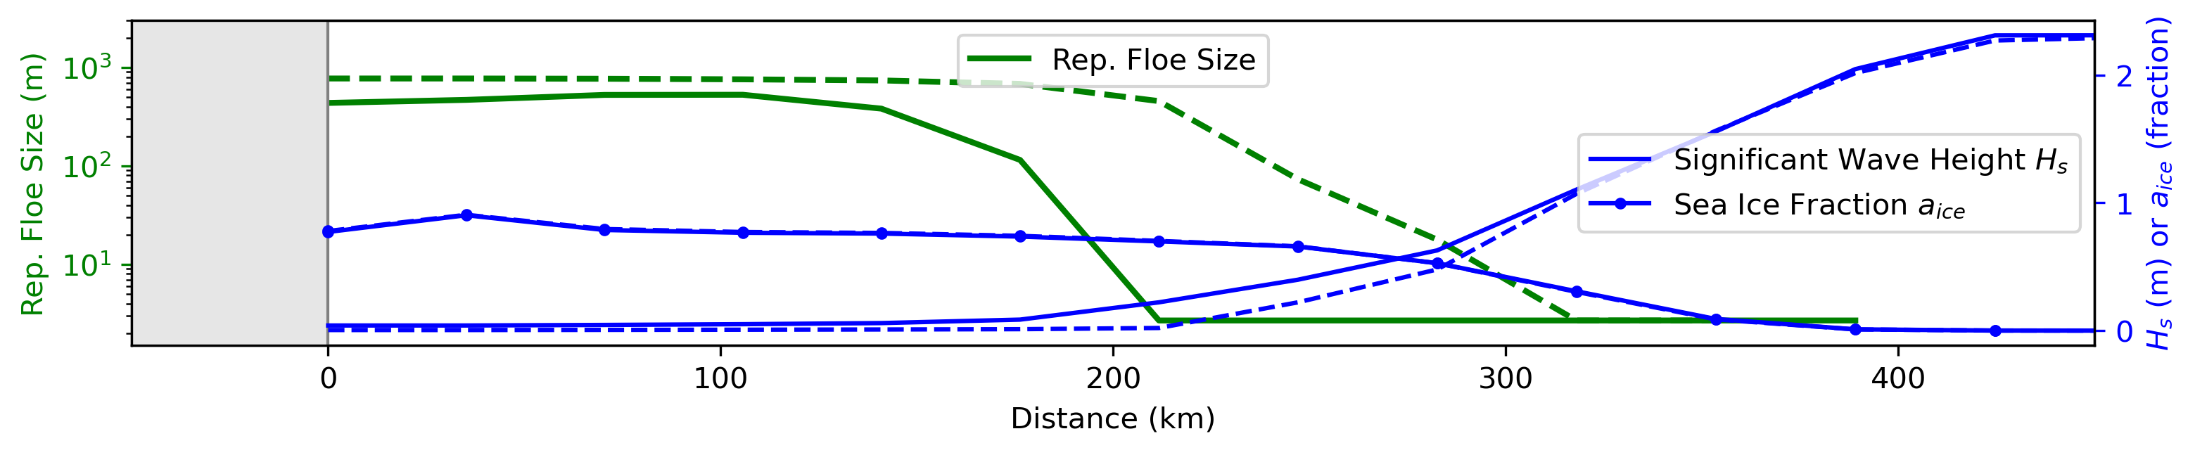
Floes in Satellite Image of Greenland Sea
Fast ice
11 May 2022
in MODIS
Open Seas
Greenland
11 May 2011
in model
Model Transect through Greenland Sea: Improved Merged Numerics (Solid) & Original Split Numerics (Dashed)
Greenland
Notes:
Representative floe size (i.e., floe-size distribution mean), significant wave height, and sea ice fraction on a transect along a meridian in the Weddell Sea on a day in March in a fully-coupled CESM2.3 simulation with wave-sea ice floe-size interactions. Dots indicate grid spacing. Simulated floes are biased small, but capture the general pattern of larger floes nearer the continent and highly fractured nearer to the sea ice edge.

Slide 6
The rest of these slides get a bit more into the weeds

Slide 7
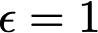
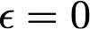
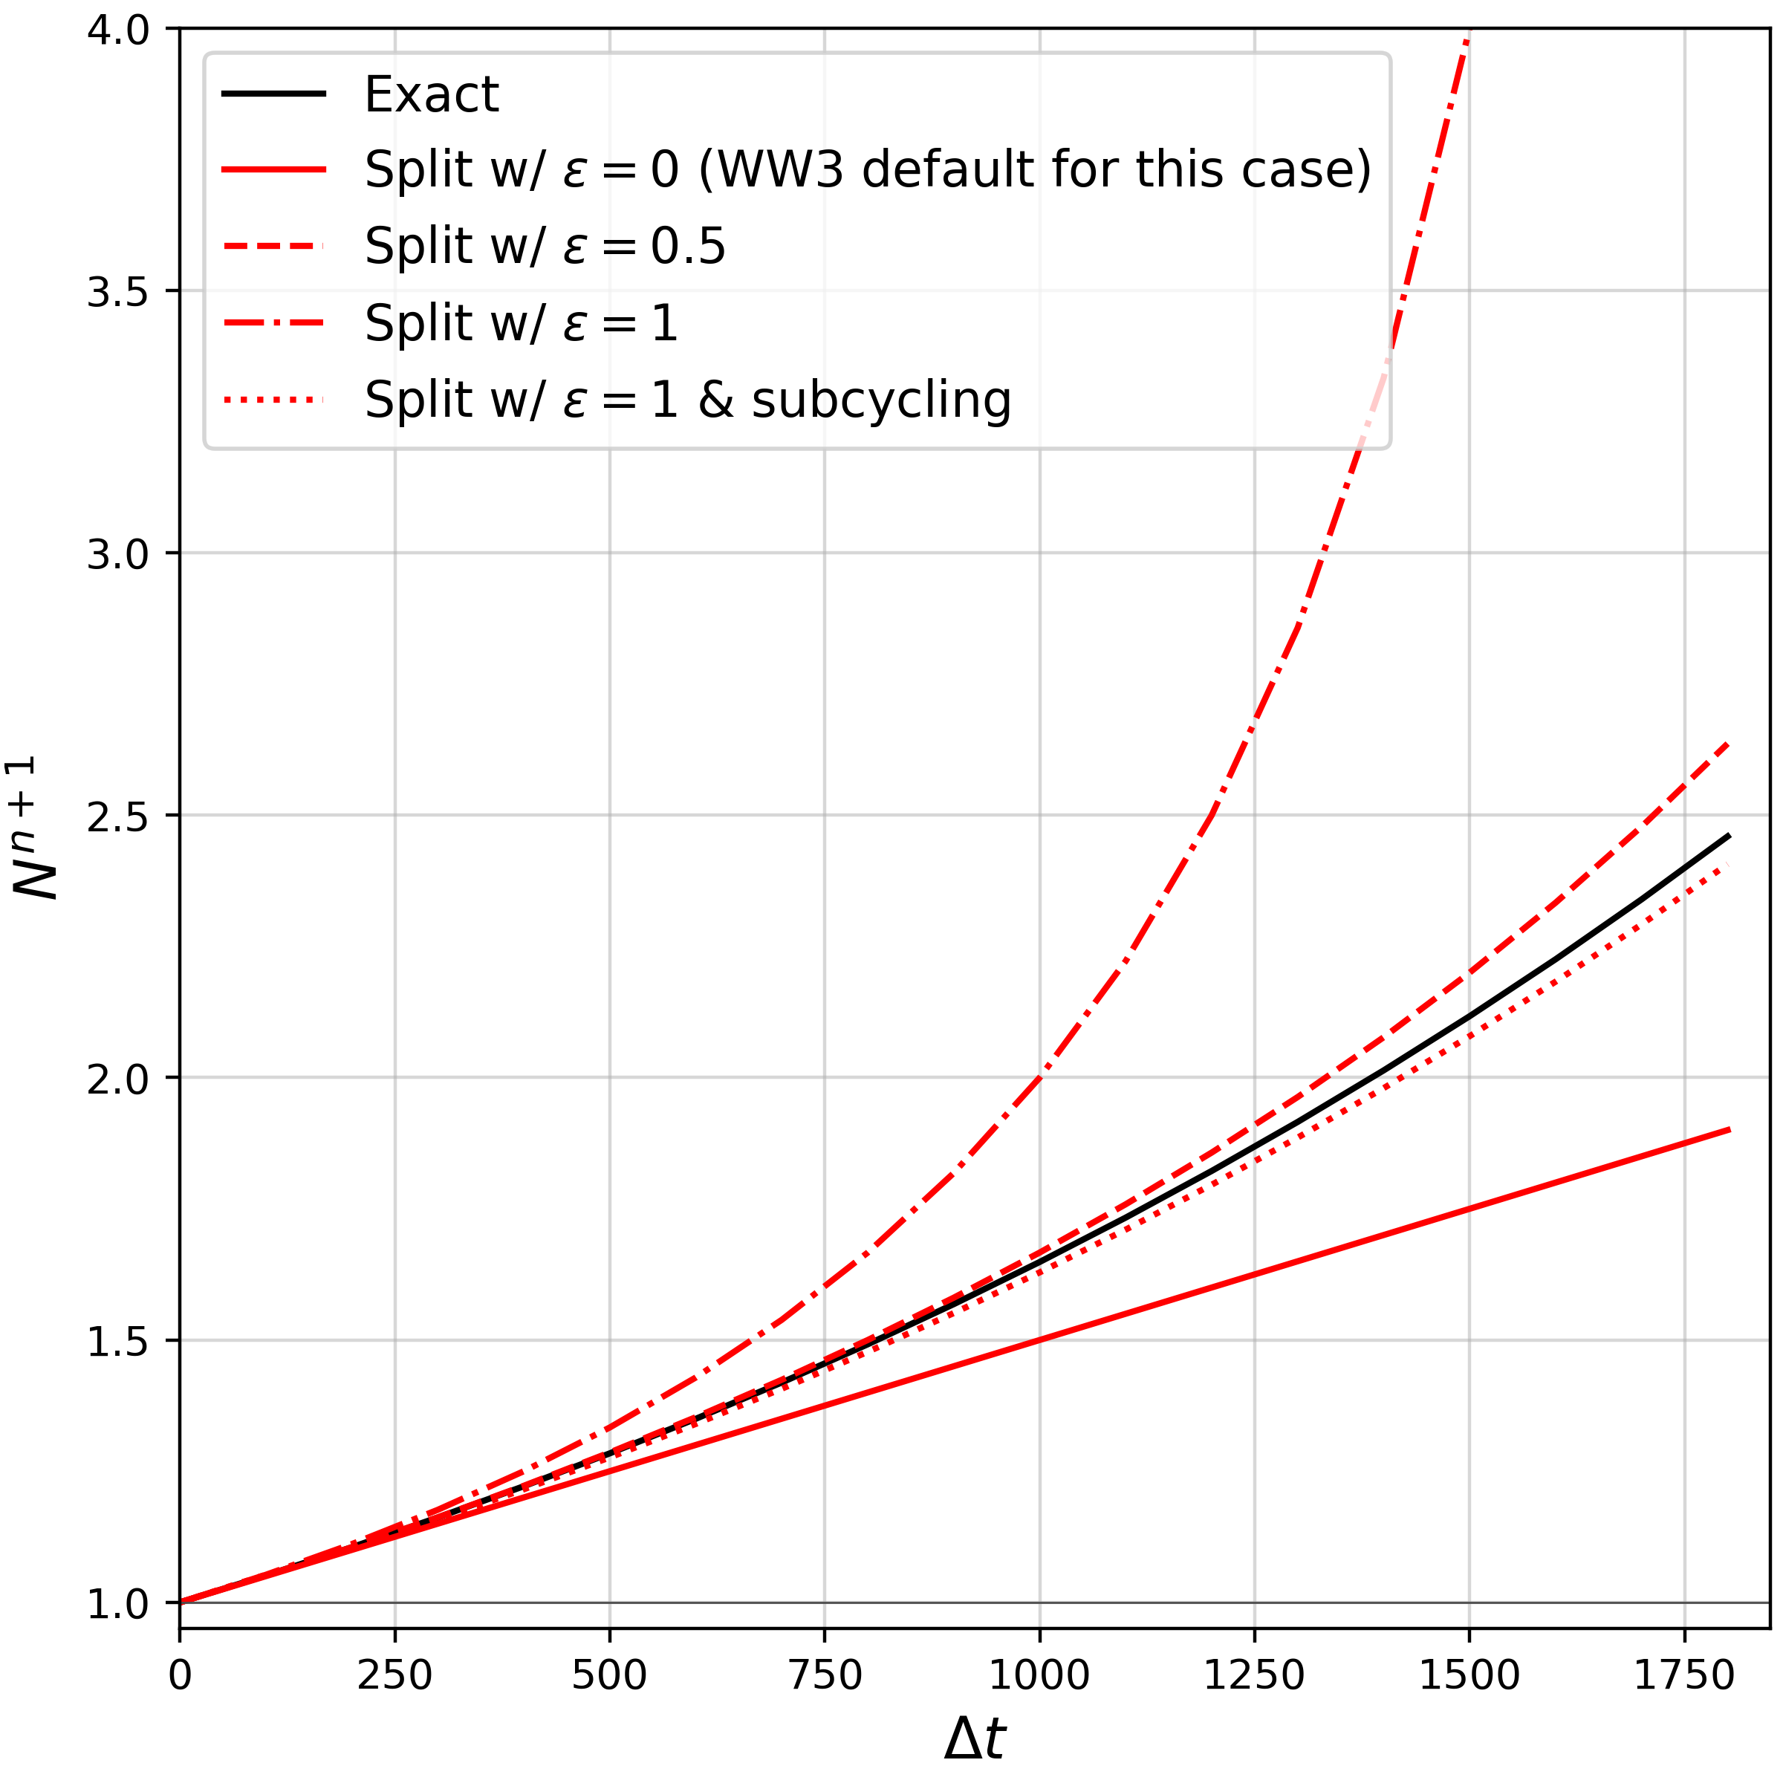
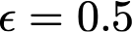
There are a few other considerations that are covered in the documentation that I’ll summarize here. The original WW3 original code had when D_{no ice}<0 and when D_{no ice}>0 and had turned off adaptive subcycling. These choices led to inaccuracy and overdamping, as explained in the documentation and shown next in figures taken from the Python Notebook included with these slides.
Left is Case A, which has wind energy input but no sea ice attenuation, so it is the solution to step 1 only. Merging has no affect, so we only show one solution method and call it ”Split” though it could equally well be called Merged. We vary and show the influence of subcycling.
The main point is that causes excess growth, which may explain why instead was chosen for conditions with
D_{no ice}>0. However, causes high damping instead. The best choice without subcycling is and with subcycling, any epsilon is equally good. Though in retrospect, we don’t recommend subcycling since it is too costly.

Slide 8
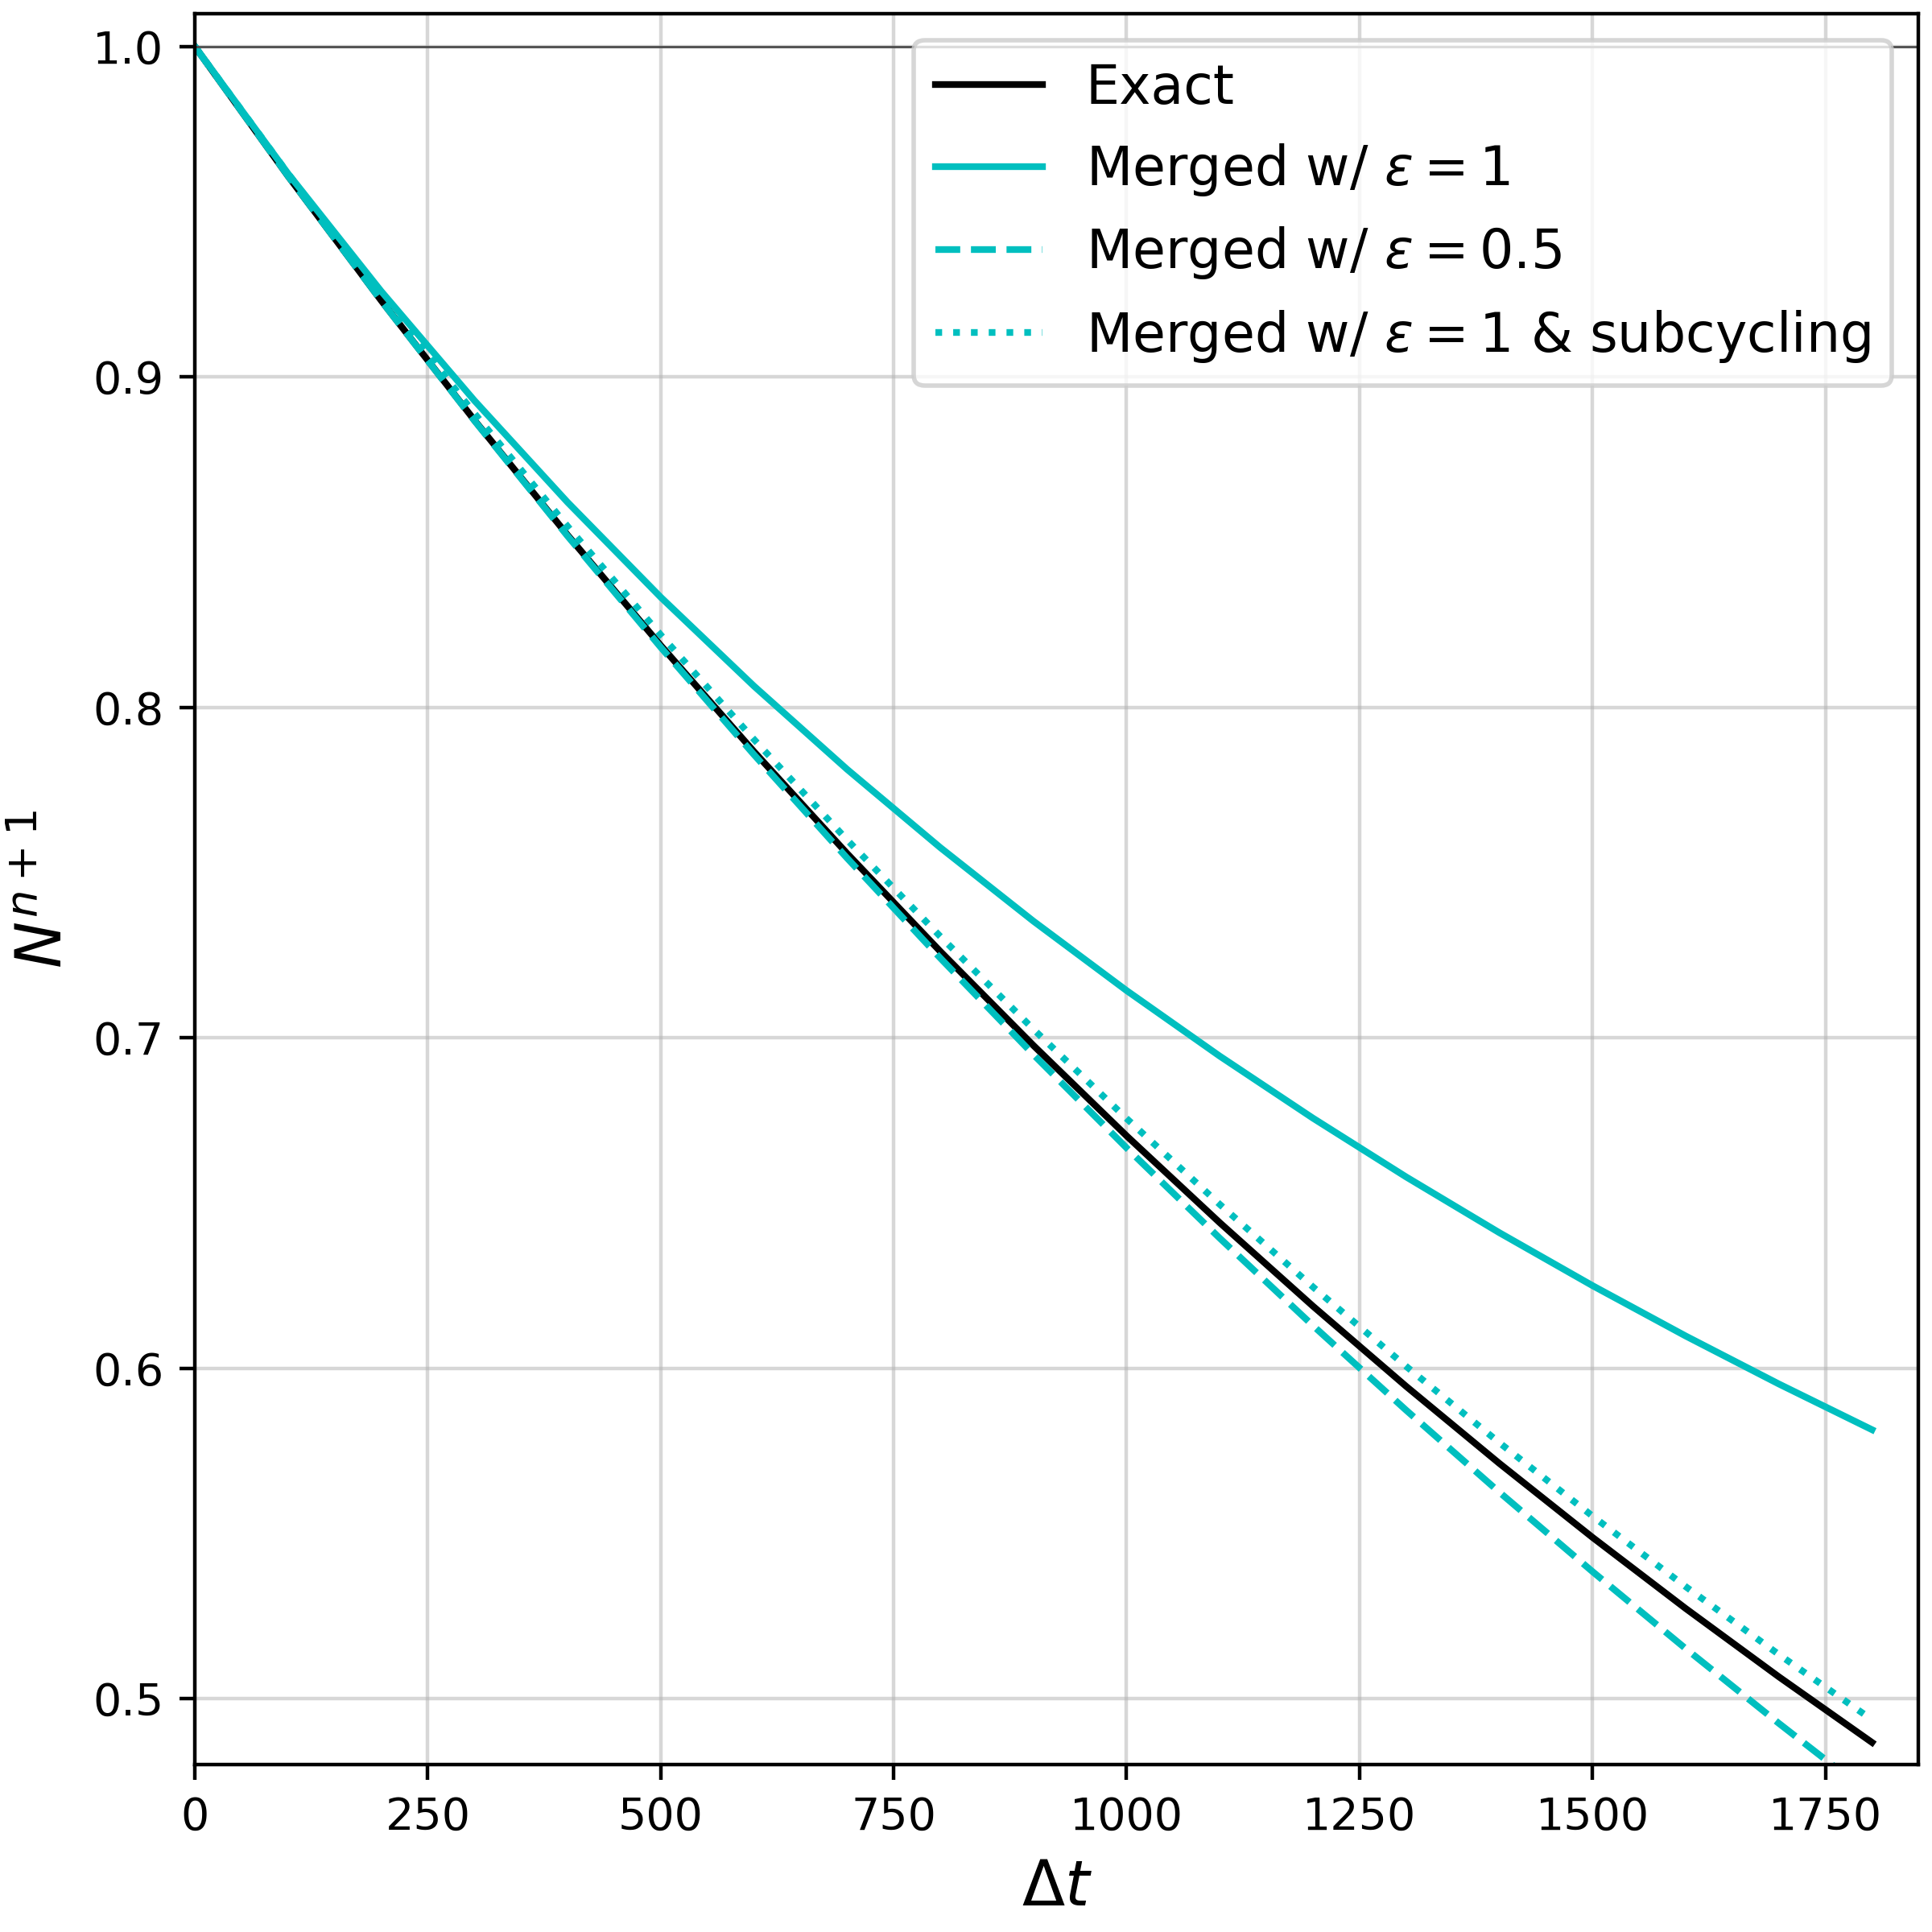
Left is Case B, which has no wind energy input but does have sea ice attenuation, so it is the solution to step 2 only. In this case the Split solution is equal to Exact. We show this case because the Merged solution is necessarily less accurate than Split since it is not exact.
The sensitivity to is about the same as for Case A. Again is fantastic even without subcycling. Subcycling with any is excellent of course. Though in retrospect, we don’t recommend subcycling since it is too costly.

Slide 9
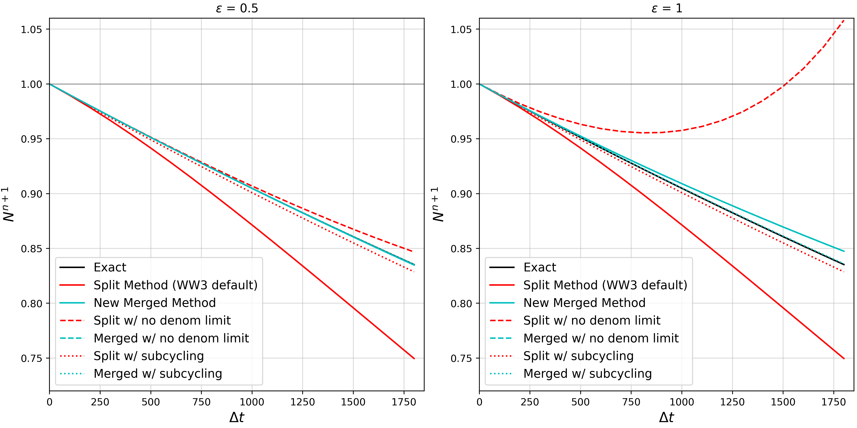
Case C, has wind energy input and greater sea ice attenuation, so it should be net damping. Here the net input + attenuation is damping so the merged solution will not make , while the original WW3 split solution will have . We refer to this as “denominator limiting” when we allow WW3 to let . Below we show examples of permitting or eliminating denominator limiting. Note that it makes no difference for Merged since the merged solution is damping, but it has a huge impact on Split since step 1 is growing. It can be helped by subcycling though.
Here, Merged is always pretty accurate, and is fantastic when or subcycling is employed. Though in retrospect, we don’t recommend subcycling since it is too costly.

Slide 10
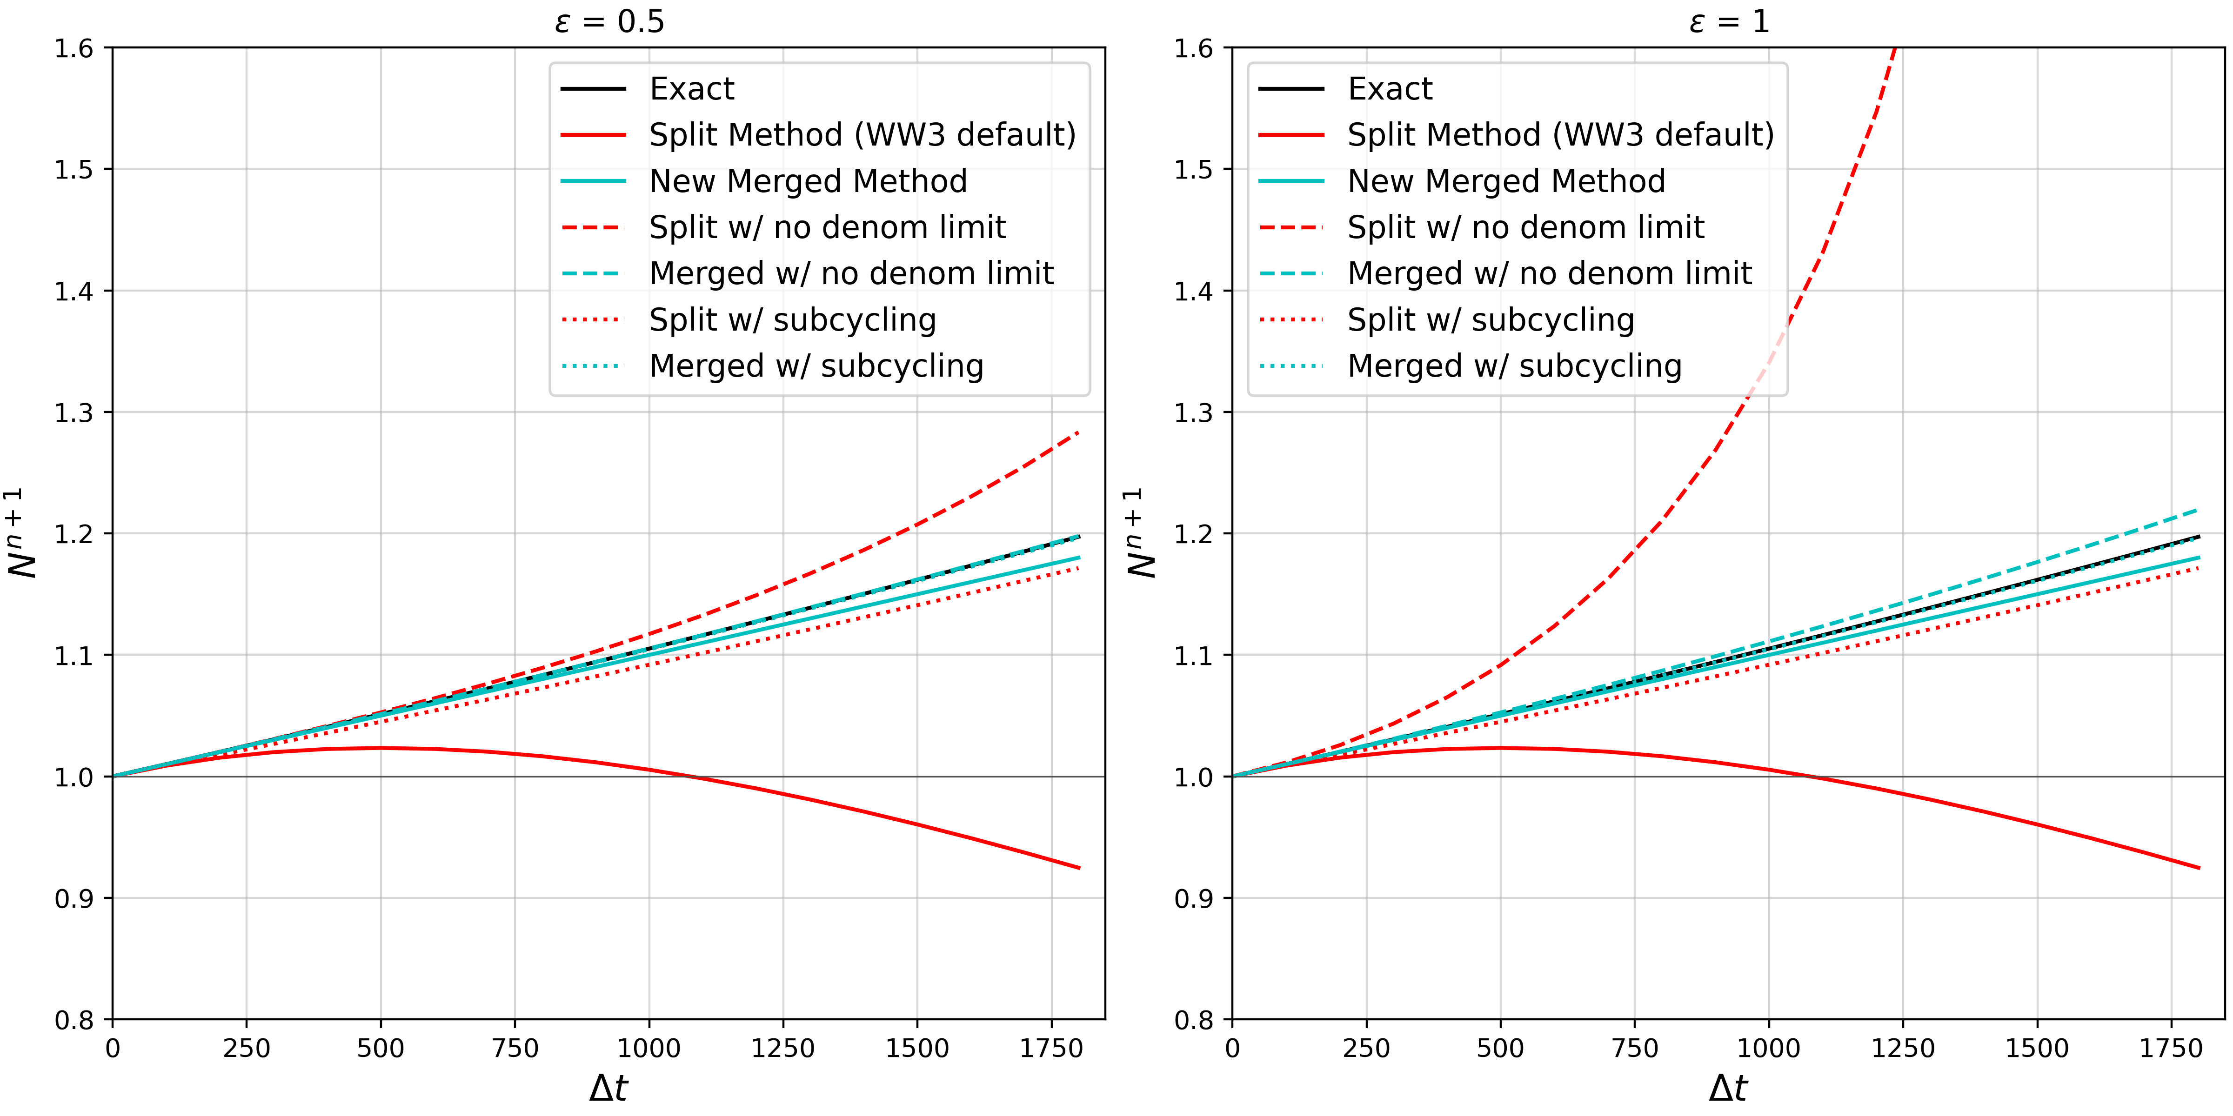
Case D, has wind energy input and less sea ice attenuation, so it should be net growing. Hence permitting denominator limiting will force for both Split and Merged. Below we show examples of permitting or eliminating denominator limiting.
Here, Merged is always pretty accurate, and it is fantastic when subcycling is employed. Though in retrospect, we don’t recommend subcycling since it is too costly.

Slide 11
Overall conclusion – The new Merged solution is great, even with the current choice for epsilon and no subcyling permitted in WW3.
We don’t understand why epsilon is set to 1 instead of 0.5 since the denominator limiter prevents excess growth either way. We recommend changing epsilon to 0.5 and keeping the denominator limiting. However, this is far less important than Merging, and we don’t want this recommendation to distract from our #1 message.
Please Merge!

Slide 12
Back to results from CESM3: Timing and Other Stuff
Experiment | Timing (s/mday)
Original WW3 numerics | 3.0
ϵ=1 with subcycline (dt=10 s) | 9.0
ϵ=1 without subcycling (dt=1800 s) | 3.3
ϵ=0.5, without subcycling (dt=1800 s) | 3.4
All experiments have ww3 on the wgx3v7 grid, which is 3 deg with 128 cpu. The global timestep is 1800s and dtmin = 10s. Hence, Experiment 2 had dt=10 s and subcycled in sea ice, which is total overkill.
We don’t recommend any subcyling at all, but if one is super paranoid about accuracy, by all means go ahead and make dt 100s for subcycling in ice. It will probably have a timing of something like 4 or 5 s/mday.

Slide 13
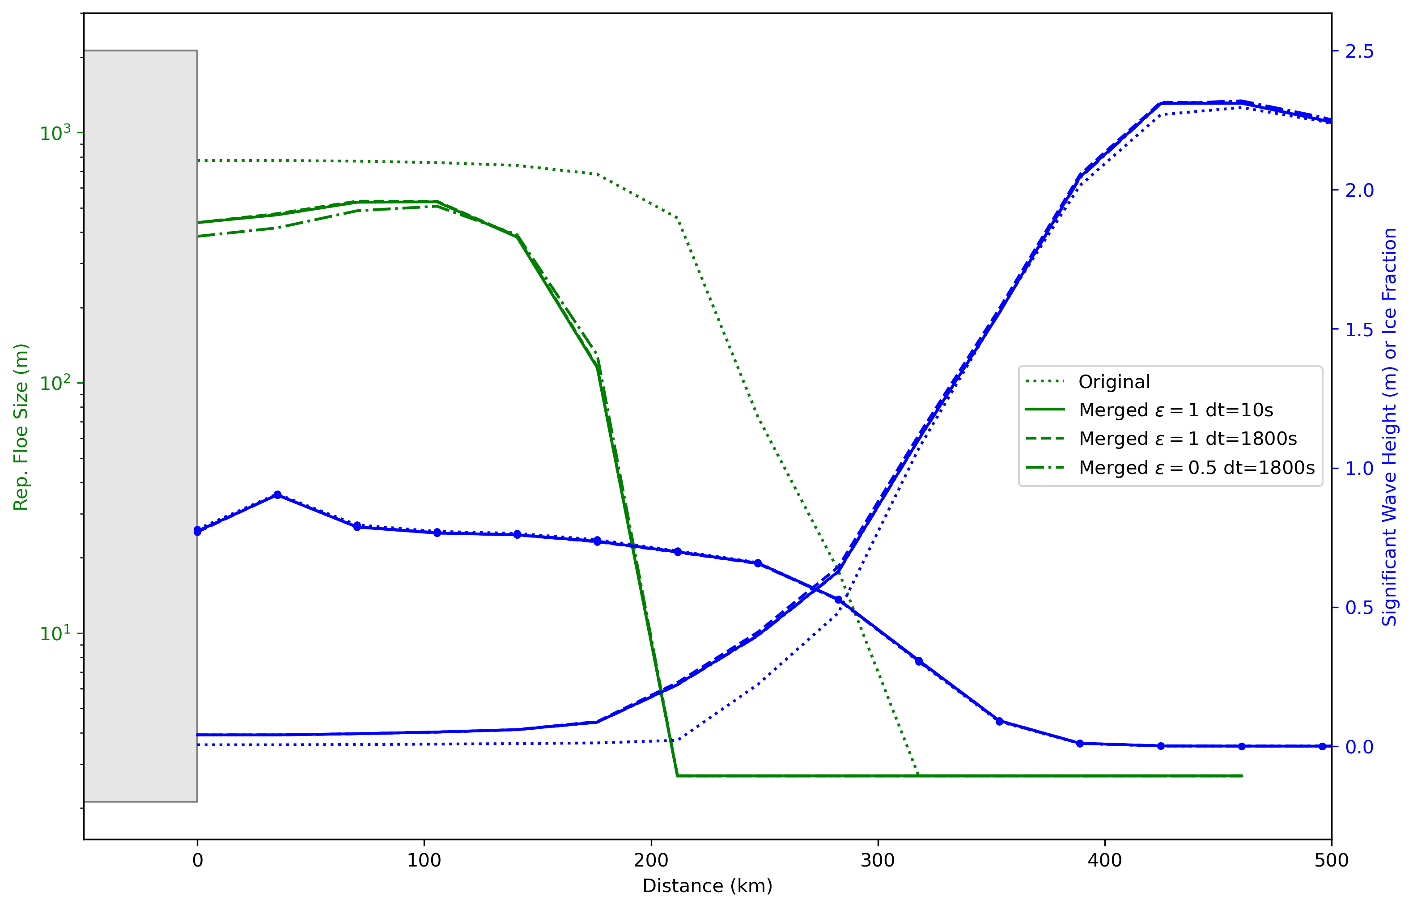
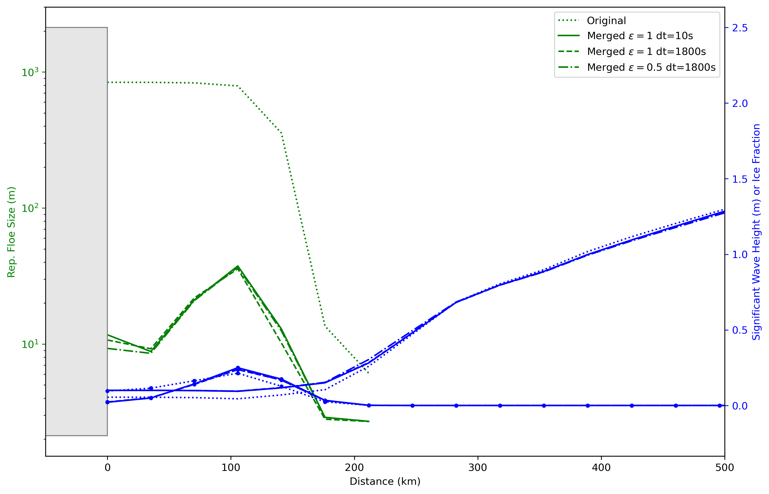
Transects through the Greenland Sea, with Greenland on left, open seas on right.
In area of active advection from north. Ice fraction is the blue line with blue dots, dots are on the model grid. We see in May that the wave heights were high that day and waves penetrated much further into sea ice with all ”merged” schemes. Ice is heavily fractured for 100 km deeper into the ice. The day in August has smaller waves but the cumulative influence on ice floe sizes over time is still massive. The specific parameter choice is much less important, as long as the new improved merged numerics are employed.
May 11, 2011
Aug 11, 2011

Slide 14
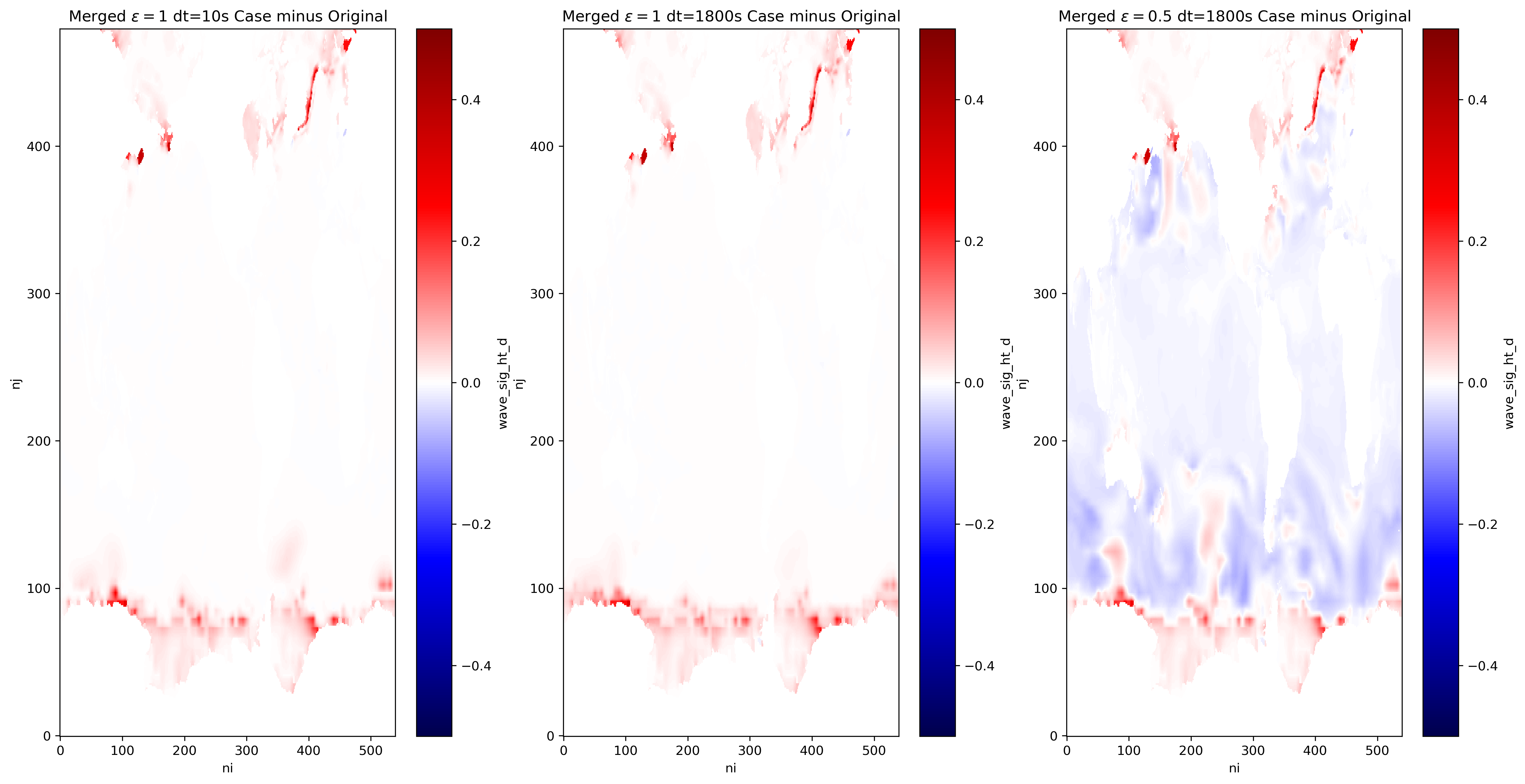
These figures show the response of significant wave height to merged numerics and other parameters on global domain on May 11, 2011. Of course there is no impact outside of the sea ice for the first two with epsilon = 1. The third panel has epsilon = 0.5 which is a more accurate solution and clearly shows that making epsilon = 1 has overdamped waves almost everywhere. We question why WW3 has epsilon=1 since the solution with epsilon=0.5 looks fine.

Slide 15
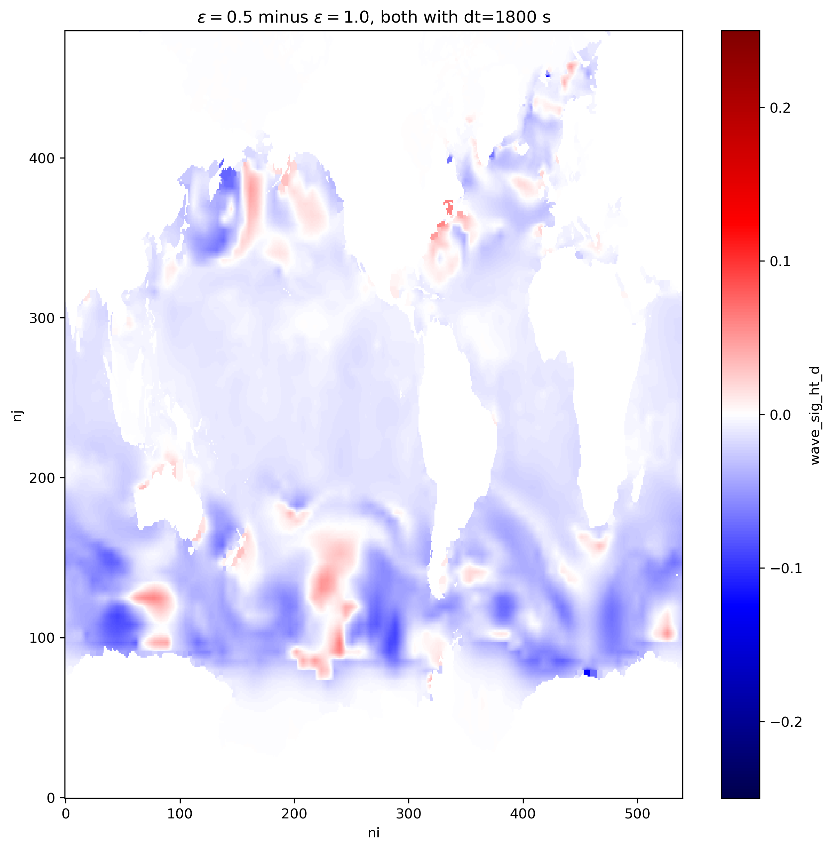
These figures show the response of significant wave heights to epsilon = 0.5 vs epsilon = 1. We keep denominator limiting and both have our new Merged numerics (which only matters in sea ice). The difference is largest here where waves are largest.
epsilon = 0.5 is more accurate, and this figure shows that by making epsilon-1, WW3 generally has about 5 to 10 cm smaller wave heights (out of ~5 m), or about 1-2%.
We don’t think epsilon = 1 is needed and the more accurate epsilon = 0.5 should be adopted.

Slide 16
Repeating our overall conclusion – The new Merged solution is great, even with the epsilon=1, with the denominator limiter, and with no subcyling permitted in WW3. We don’t recommend subcyling.
We don’t understand why epsilon is set to 1 instead of 0.5 since the denominator limiter prevents excess growth either way. We recommend changing epsilon to 0.5 and keeping the denominator limiting. However, this is far less important than Merging, and we don’t want this recommendation to distract from our #1 message.
Please Merge!

